Slide 1
Generics & Annotations
Prerna Gandhi November 3, 2020
CONFIDENTIAL | © 2020 EPAM Systems, Inc.

Slide 2
GENERICS

Slide 3
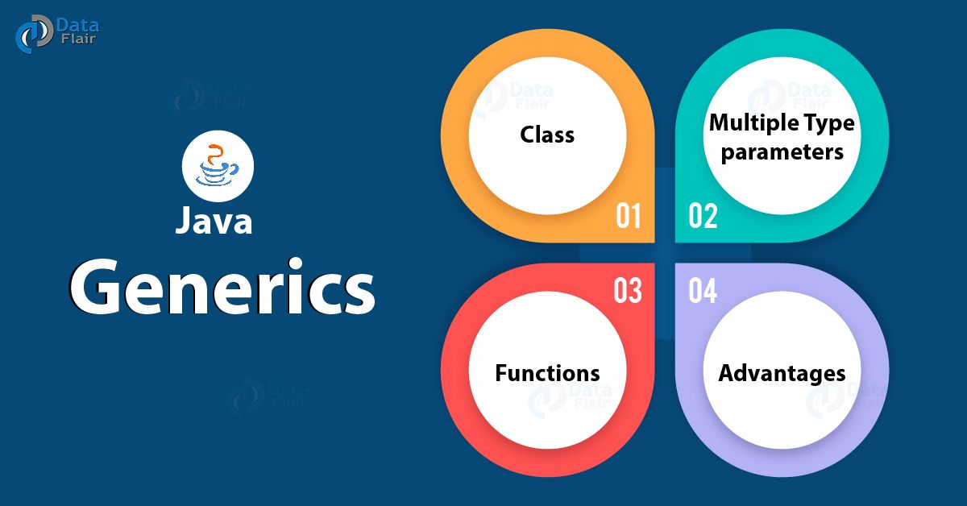
GENERICS:
G
E
N
E
R
I
C
S
Before Generics
Example using Generics
Generic Methods
Generic Classes
Generic Interfaces
Bounded Type Parameters
Wildcards
Type erasures

Slide 4
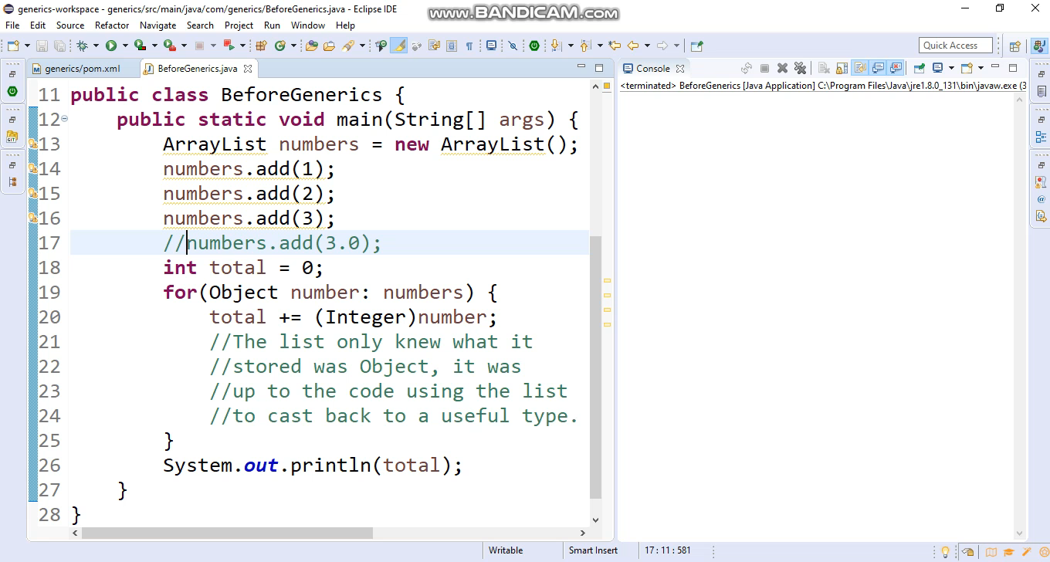
BEFORE GENERICS
Before generics, Type casting was used.
ISSUE WITH TYPE CASTING
Can’t handle exceptions at compile time.
risk of ClassCastException and explicit casting of objects.

Slide 5
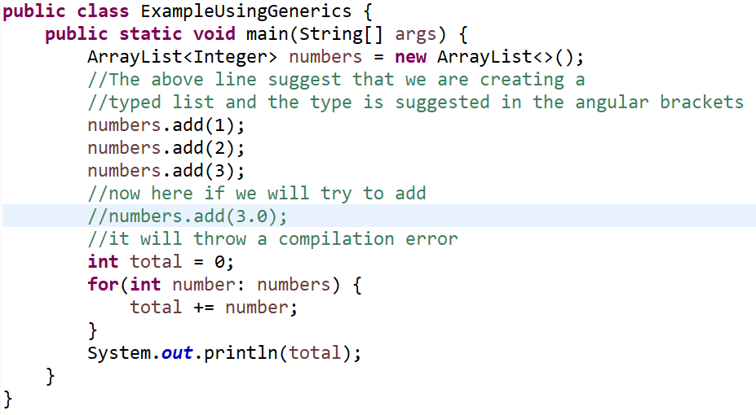
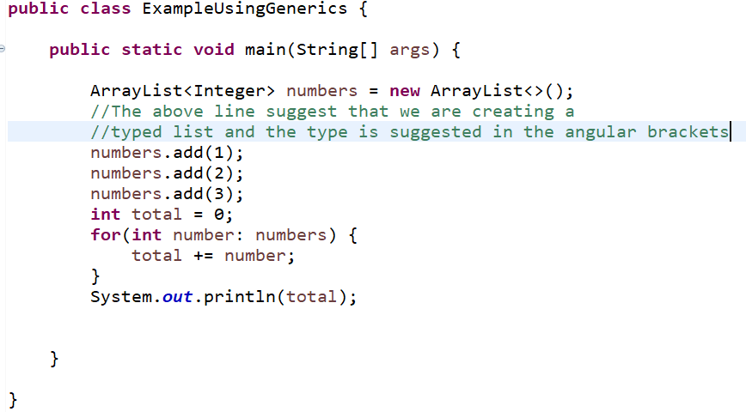
EXAMPLE USING GENERICS

Slide 6
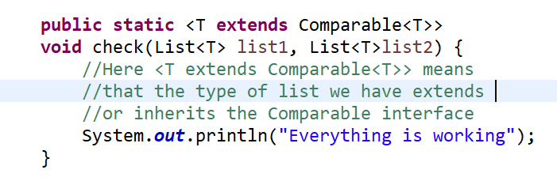
GENERIC METHODS
SYNTAX OF GENERIC METHOD
EXAMPLE
public static <E> void print(E[] elements){}
Static and non-static methods can be generic

Slide 7
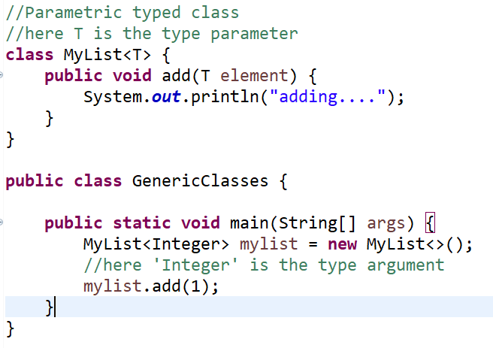
GENERIC CLASSES
SYNTAX OF GENERIC CLASS
EXAMPLE
class nameOfClass<T1,T2,…,TN>{/*…..*/}
nameOfClass <K> val;
T1, T2,… are type parameters
K is type argument

Slide 8
GENERIC INTERFACES
SYNTAX OF GENERIC INTERFACE
EXAMPLE
interface genericInterface<T>
Here T is type parameter
Comparable is a great example of Generic Interfaces
public interface Comparable<T> {
public int compareTo(T o);
}

Slide 9
GENERICS BOUNDED TYPE PARAMETERS
SYNTAX OF BOUNDED TYPE
PARAMETER
EXAMPLE
<T extends superClassName>

Slide 10

WILDCARDS
Question mark (?) is the wildcard in generics
and represent an unknown type. The wildcard
can be used as the type of a parameter, field,
or local variable and sometimes as a return type.
We can’t use wildcards while invoking a generic
method or instantiating a generic class. In
the following sections, we will learn about
upper bounded wildcards, lower bounded
wildcards, and wildcard capture.
Types:
<? extends A> (Upper Bounded Wildcards)
<? super A> (Lower Bounded Wildcards)
<?> (Unbounded Wildcard)

Slide 11
Type Erasures
It is the process of removing type information from generic code
Eg: List<Integer> can be converted to List
This is referred to as the raw type, which bypasses the checks of generic types
The way to implement generics, the Java compiler applies type erasure

Slide 12
ANNOTATIONS

Slide 13

ANNOTATIONS:
A
N
N
O
T
A
T
I
O
N
S
Introduction
Annotation Structure
Types Of Annotations

Slide 14
INTRODUCTION
Annotations are used to provide supplement information about a program.
Start with ‘@’.
Do not change action of a compiled program.
Help to associate metadata information
Not pure comments
Can change the way a program is treated by compiler.

Slide 15
ANNOTATION STRUCTURE
There are two main components in annotations
First is annotation type
Second is the annotation itself
Every annotation belongs to an annotation type

Slide 16
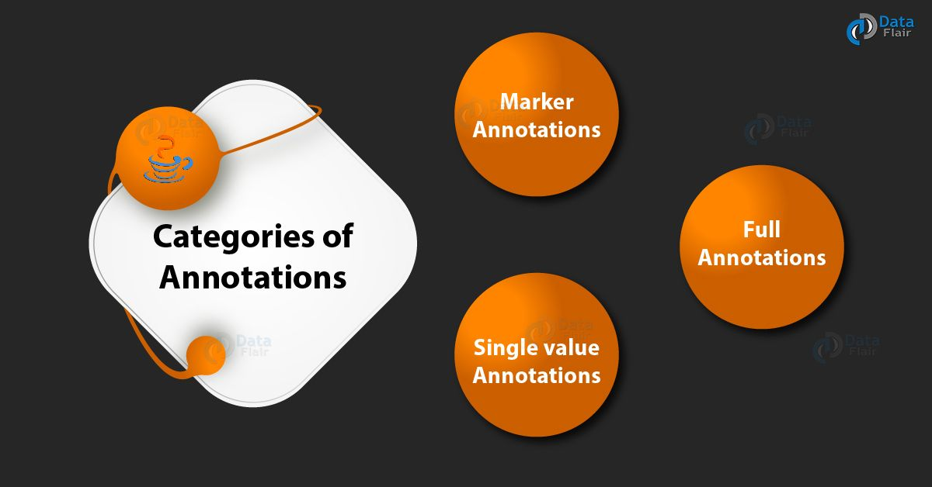

Slide 17
MARKER ANNOTATION
The only purpose is to mark a declaration. These annotations contain no members and do not consist any data. Thus, its presence as an annotation is sufficient. Since, marker interface contains no members, simply determining whether it is present or absent is sufficient.
@Override is an example of Marker Annotation.
Example: - @TestAnnotation()

Slide 18
SINGLE VALUE ANNOTATIONS
These annotations contain only one member and allow a shorthand form of specifying the value of the member.
We only need to specify the value for that member when the annotation is applied and don’t need to specify the name of the member.
However in order to use this shorthand, the name of the member must be value. Example: - @TestAnnotation(“testing”);

Slide 19
FULL ANNOTATIONS
These annotations consist of multiple data members/ name, value, pairs.
Example:- @TestAnnotation(owner=”Rahul”, value=”Class Geeks”)

Slide 20

REFERENCES
https://www.journaldev.com/1663/java-generics-example-method-class-interface
https://www.geeksforgeeks.org/generics-in-java/
https://www.linkedin.com/learning/java-generic-classes/next-steps?u=2113185
https://www.journaldev.com/721/java-annotations
GitHub Link : https://github.com/PrernaGandhi/generics

Slide 21
Q/A?

Slide 22
THANK YOU

